Slide 1

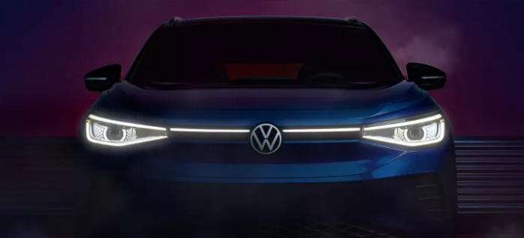

i.mobilothon 4.0
VolksWagen
VOLKSWAGEN AUTOPILOT+
Welcome the next Generation Automation
Sanghamitra Nayak

Slide 2
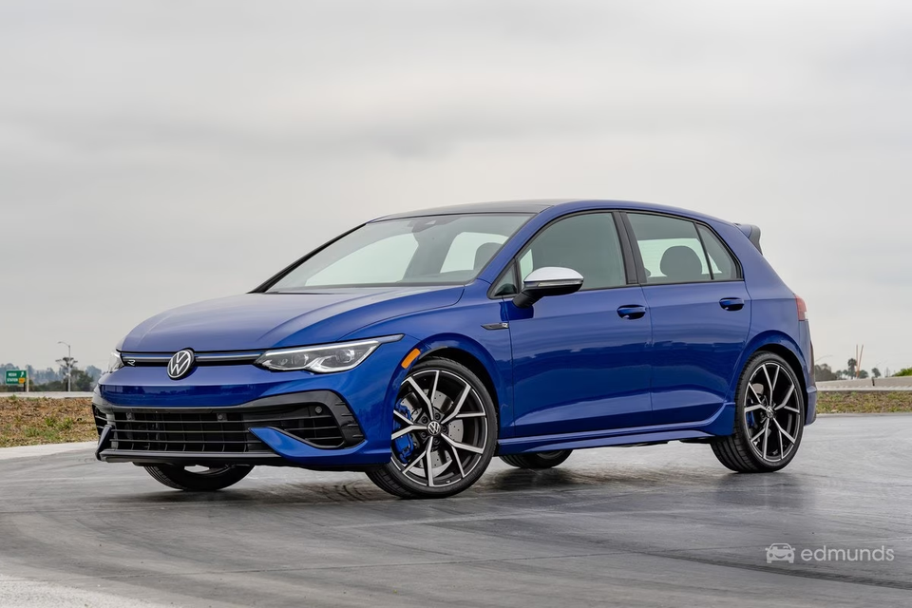

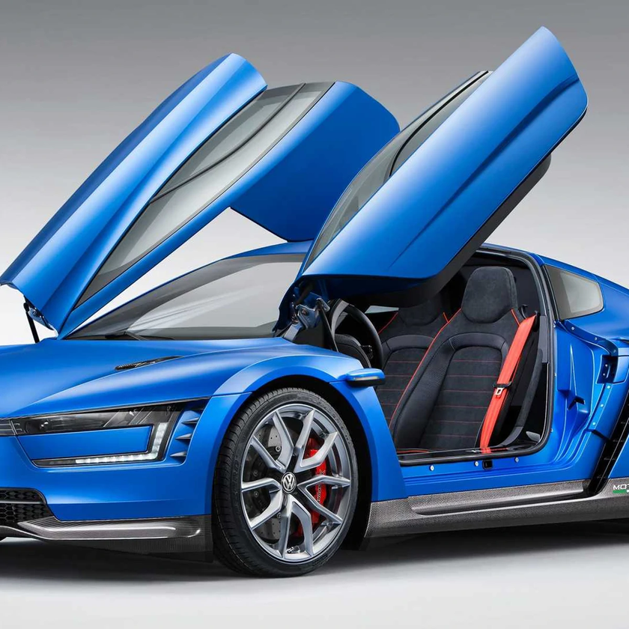
Problem Statement
Current autonomous vehicles focus on navigation but neglect passenger experiences. Daily commuters face stress in traffic, business travelers waste time, and families struggle to stay entertained.
Today’s cars are mere tools for mobility, missing the potential to enhance well-being, productivity, and enjoyment. AutoPilot+ bridges this gap, turning vehicles into smart spaces tailored to passenger needs.

Slide 3
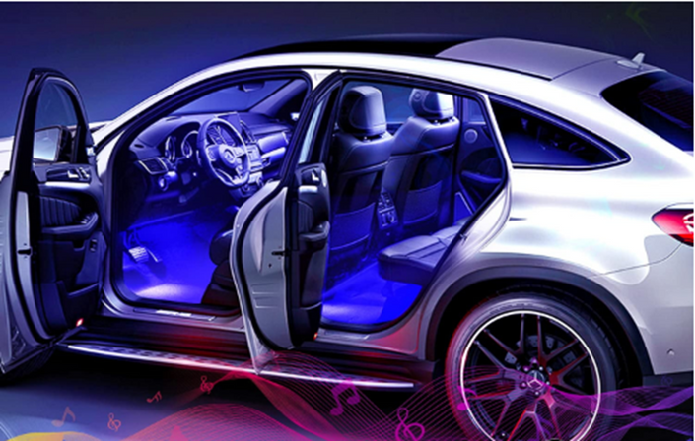
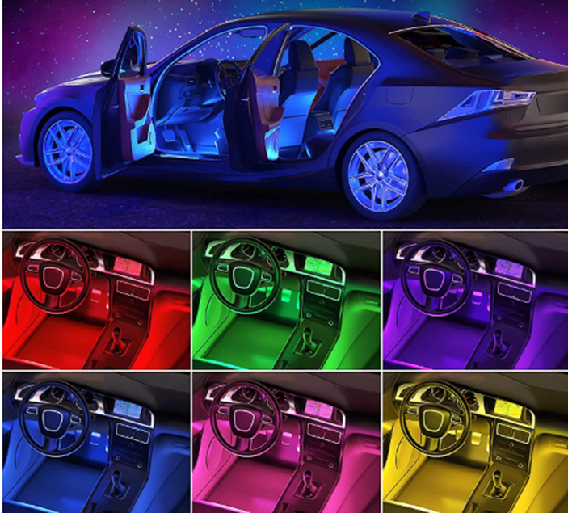
Solutions Overview
Volkswagen AutoPilot+: An AI-enhanced in-car experience integrated into autonomous fleets.
Key Features:
Adaptive In-Vehicle Experience: Adjusts temperature, lighting, and seating based on mood and preferences.
Health Integration: Real-time monitoring via seat sensors and AI-driven stress-relief recommendations.
Productivity Mode: Converts the car into a smart office by syncing schedules, managing calls, and displaying briefs.
Entertainment Mode: Tailored recommendations for music, movies, and virtual tours, enhancing leisure.

Slide 4


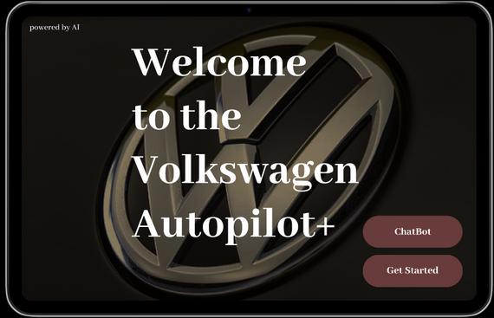
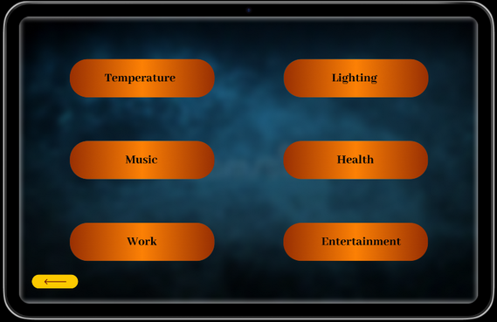
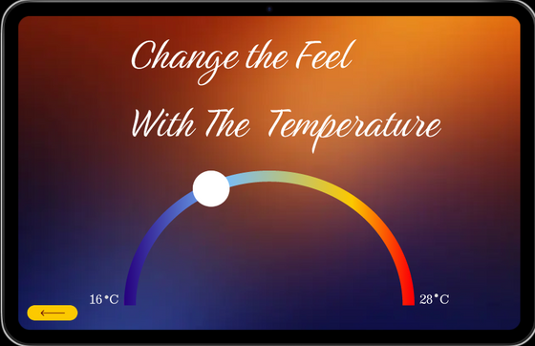
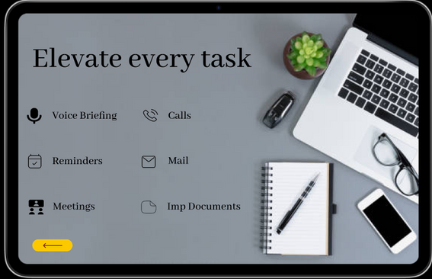
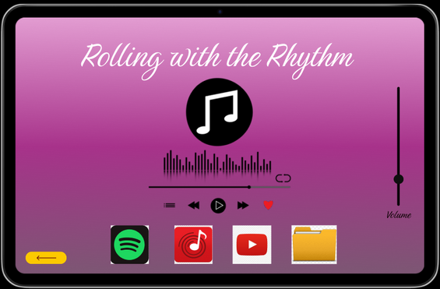
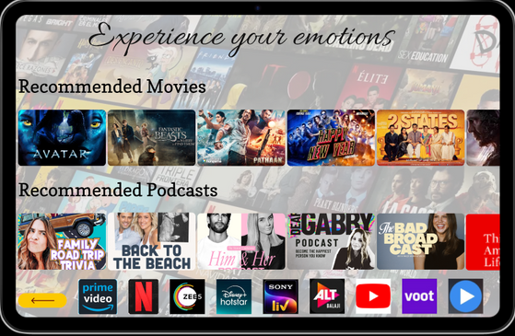
Product Features
AI-Driven Personalization:
Learns from user preferences and adjusts cabin
settings dynamically.
Health & Well-Being Integration:
Monitors stress levels using heart rate sensors,
suggesting breathing exercises or
relaxation techniques.
Productivity Enhancements:
Manages professional tasks like emails, calls,
and reminders seamlessly.
Immersive Entertainment:
Offers personalized content via Spotify integration,
movie databases, and virtual tour guides.

Slide 5
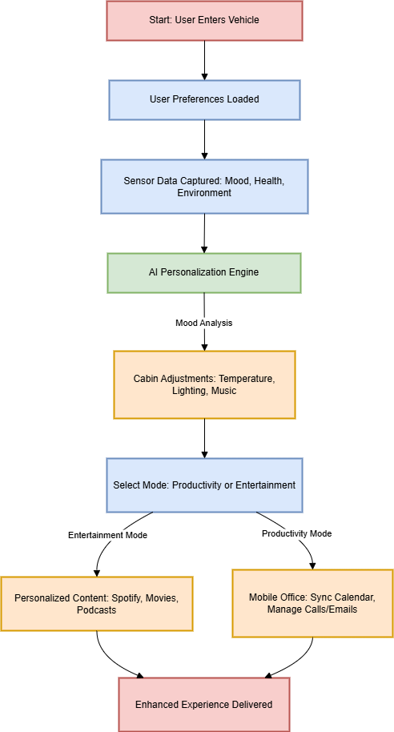
Prototype Demonstration
User Flow:
Passenger enters the vehicle, and the system loads their preferences.
Sensors detect mood, stress levels, and environmental conditions.
AI personalizes the cabin experience in real-time.
Modes such as Productivity or Entertainment are activated based on user input or context.
Continuous feedback loop enhances future interactions.

Slide 6
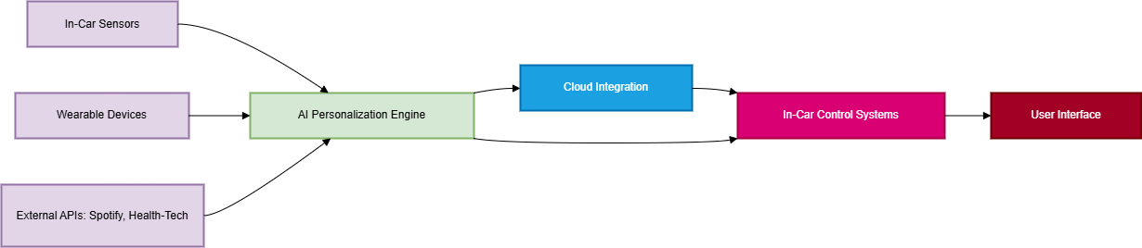
Technical Architecture
System Layers:
AI Personalization Engine: Central decision-making unit leveraging machine learning.
Health Monitoring Module: Collects real-time data from sensors embedded in seats and steering wheels.
Cloud Integration: Syncs user profiles, updates software, and ensures secure data handling.
In-Car Control Systems: Manages adaptive features like lighting, temperature, and entertainment.
External Integrations: Partners with Spotify, health-tech APIs, and productivity tools (Google Calendar).

Slide 7
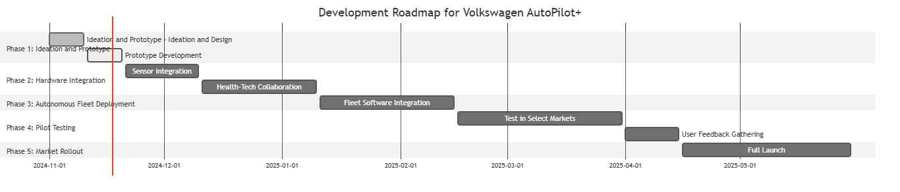
Development RoadMap
Phased Development
Phase 1: Ideation and Prototype Development
Develop initial Figma designs and AI algorithms.
2.Phase 2: Hardware Integration
Collaborate with health-tech providers for sensor deployment
3.Phase 3: Fleet Deployment
Equip autonomous vehicles with AI-driven systems.
4.Phase 4: Pilot Testing
Conduct user trials, refine features based on feedback.
5.Phase 5: Market Rollout
Launch in regions with established autonomous vehicle regulations.

Slide 8
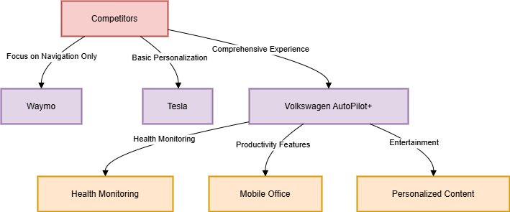
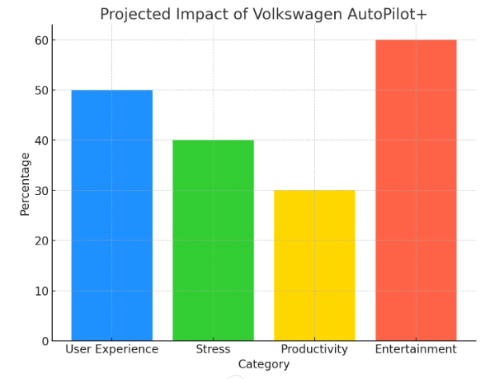
Market Impact
Volkswagen AutoPilot+ revolutionizes in-car experiences, as:
Enhanced User Experience : AI-driven personalization boosts satisfaction by 50%, creating an adaptive and enjoyable environment for passengers.
Health Benefits : Stress-relief features reduce stress by up to 40%, improving well-being during commutes.
Productivity Boost : Business travelers gain 30% efficiency with tools like meeting preparation and voice-activated management during their journeys.
Enriched Entertainment : Personalized content,
such as curated playlists and virtual tours,
enhances engagement, making trips more enjoyable.

Slide 9
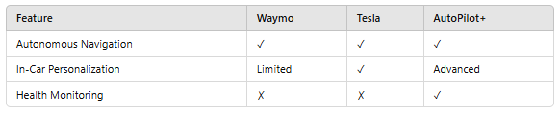
Competetive Advantage
Why AutoPilot+ Stands Out:
Comprehensive Adaptability: Unlike other autonomous systems, AutoPilot+ integrates multiple dimensions of user experience, including navigation, health monitoring, productivity tools, and entertainment ensuring the vehicle becomes a versatile space for both the journey and personal well-being.
Advanced Personalization: AutoPilot+ learns from each interaction, continuously evolving to provide a tailored experience. Whether it’s adjusting climate settings, recommending music, or suggesting break points based on driving patterns, the system adapts to the user's needs in real-time.
Health Focus: AutoPilot+ offers integrated stress management features, it monitors physical and emotional well-being, providing real-time health alerts and tailored advice, such as breathing exercises or suggestions to take a rest, ensuring drivers stay calm and alert.

Slide 10
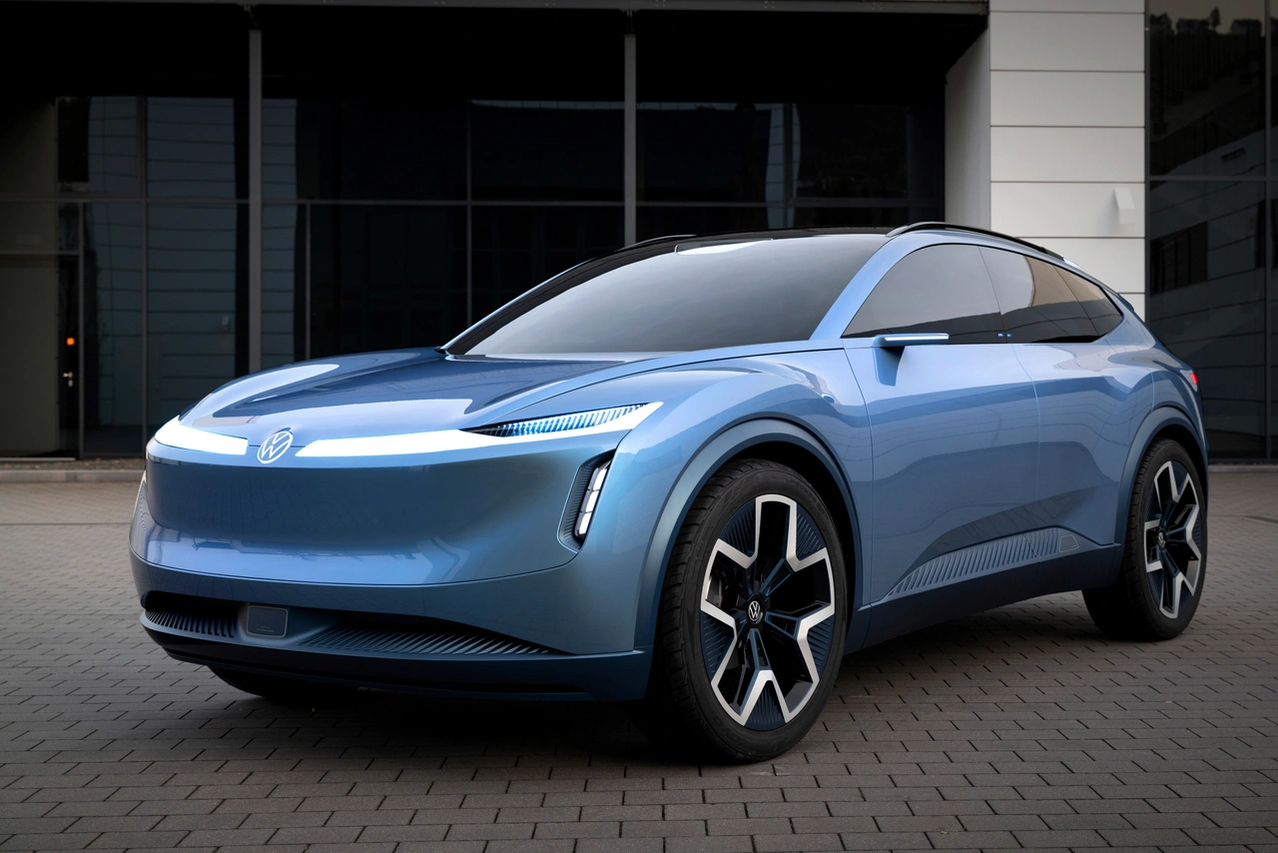




"The best way to predict the future is
to invent it." - Alan Kay
Volkswagen
THANK YOU
Sanghamitra Nayak
+91 9594656932
sanghamitra0118@gmail.com
https://www.linkedin.com/in/sanghamitra-nayak/
i.mobilothon 4.0
Volkswagen Group Technology Solutions India

